Slide 1
Bully Project in PHIL 1312
North American University
2017
Team: Geraldo Braho, Ravshanbek Norboev, Maksat Taganov, Sekou Omar Barke Doka , Enes Sevik, Mehmet Icme, Hakan Bilgi

Slide 2
Bullying in Albania
Geraldo Braho

Slide 3
Definition(Albanian &English)
Bully- detyroj ( translation to Albanian)
Detyroj – e shtrëngoj dikë që të bëjë një punë a diçka tjetër pa dëshiren e pa vullnetin e vet.
Detyroj – make( force) someone to do a work or something else without his/her will.
Bully- a person who uses strength or power to harm or intimidate those who are weaker.(English-English)
Notes:
Bullying has become rampant in all schools all around the world. Thousands of kids are insulted, picked upon and demoralized by being called a colorful plethora of derogatory names. Yes, school is supposed to be tough. But it’s not supposed to be so tough that it makes you want to hide beneath your covers and stay at home. Usually children are ready to face the most stringent teachers but they are terrified of encountering a crowd of bullies. Although many steps have been taken to put a halt to it over the years, there is no denying that the bullying epidemic still exists today. It has been estimated by research that the bullying epidemic has worsened even more over time due to the increased diversity of beliefs and cultures. The fear of being bullied has pushed around 160,000 students into staying at home instead of attending school. As a matter of fact, bullying has also paved way for the concept of home schooling. The dangerous part about bullying is that victims of this act are 2-9 times more likely to consider suicide as a means of escape.

Slide 4
Characteristics of bully
Aggressive bullies – young people who fall in this category tend to be physically strong, impulsive, hot-tempered, belligerent, fearless, confident, and lacking in empathy for their victims.
Passive bullies- unlike the ultra-confident aggressive bullies, tend to be insecure. They are also much less popular then aggressive bullies and often have low-self esteem, few likable qualities and unhappy home lives.
Bully-Victims- represent a small percentage of bullies who have been seriously bullies themselves.
Notes:
Aggressive bullies are the most common type of bully. Young people who fall into this category tend to be physically strong, impulsive, hot-tempered, belligerent, fearless, coercive, confidant, and lacking in empathy for their victims. They have an aggressive personality and are motivated by power and the desire to dominate others. They are also likely to make negative attributions, often seeing slights or hostility in those around them where neither actually exists. According to Olweus, the aggressive bully tends to be most popular in the early school years and then less so in the upper grades — perhaps because young children are more likely than older students to admire the macho image. As students get older, they become better able to think critically about peers and "leaders.”
Passive bullies, unlike the ultra-confident aggressive bullies, tend to be insecure. They are also much less popular than the aggressive bullies and often have low-self esteem, few likable qualities, and unhappy home lives. Passive bullies also appear to have difficulties concentrating and focusing their attention at school, as well as violent outbursts or temper tantrums that lead to problems with their peers. Rather than initiating a bullying interaction, passive bullies tend to hang back until one is already under way — usually at the instigation of an aggressive bully. Once a bullying incident begins, passive bullies become enthusiastic participants. In fact, passive bullies are very quick to align themselves with and display intense loyalty to the more powerful aggressive bullies. Some researchers refer to this group as anxious bullies.
Bully-victims represent a small percentage of bullies who have been seriously bullied themselves. Bully-victims are often physically weaker than those who bully them but are almost always physically stronger than their own victims. They possess some of the same characteristics as provocative victims (described below); they are easily aroused and sometimes provoke others who are clearly weaker than they are. Bully-victims are generally unpopular with their peers, and they are more likely than other types of bullies to be both anxious and depressed.

Slide 5
Bully Rationale
No such things as bullying, person did something bad to me so they have it coming, it is only teasing nothing wrong with bullying, angry, fear….trigger ?
Bully vs Teasing
Similarities
Differences
The Problem
The Solution
Notes:
Many experts argue that there are important differences between teasing and bullying. Theoretically those experts are absolutely correct.
Similarities
Both teasing and bullying usually involve poking fun at someone, ridiculing them in a way that we think is funny, making them look foolish, and generally mocking, taunting, or joking around with them. There are times when teasing and bullying can become physical.
Differences
Teasing generally involves a sense of play and mutual joshing around. Teasing will rarely, if ever, involve religion, race, appearance or other important characteristics.
Bullying does not involve play or mutual joshing around. Bullying is often about religion, race, appearance, or other important characteristics.
Bullying is differentiated from teasing because of intention. Those who bully actually intend to do harm, whereas teasing is supposed to be a ‘no harm’ game.
The Problem
There is a problem with this logic though. What matters most and is often overlooked, is that it does not actually matter what the aggressor does.
If your children are being ‘teased’ and they don’t like it, the motivation of the teaser is irrelevant. The teasing has become bullying. Your children are perceiving that harm is being done. They are victims of another person’s unkind behaviour toward them, however innocent.
A child who is teased day after day, week after week, will eventually begin to become dispirited – or worse. Teasing can be as harmful as bullying, and while theoretically different, the two are easily perceived by a child to be exactly the same thing.
The solution
By possessing a strong sense of self children can bounce back effectively from teasing. (Other articles in this section describe how you can help your child deal with mean friends, deal effectively with teasing, and develop resilience.) By nurturing your relationship with your child, you can aid in his or her success in overcoming teasing
Reporting teasing and bullying
Parents should treat each situation differently. Some children will quickly develop strategies to overcome teasing or bullying. Others will require assistance. Some teasing will disappear as quickly as it started. Other teasing will become chronic and ongoing. Parents should be discerning about becoming involved for two important reasons.
First, involvement can exacerbate the problem. Some children, in perceiving weakness, will do what they can to expose it to even greater degrees. Parental involvement may highlight a child’s weakness.
Second, involvement can undermine a child’s motivation or attempts to create change him or herself.
If you, as a parent, are concerned that teasing is affecting your child it may be helpful to report your concerns. Children should not be involved in the reporting process during the early stages. Usually a discreet conversation with your child’s teacher will be sufficient. Teachers deal with these issues regularly and can typically manage teasing effectively.
A thoughtful approach will often solve difficulties in schoolyard relationships quickly and simply, particularly if parents are honest, well-meaning, and clear in their concerns. In the event that teasing becomes worse, most schools have clear policies outlining their direction in dealing with such issues. Clear and open communication with the school principal will be the most effective way to deal with teasing and bullying should there be a need to take matters further.

Slide 6
Environment
School
Family
Public
Work Places
Notes:
Mobbing is an actual phenomenon present in developed and developing countries. Mobbing is a social pathology that flow from a destructive slow process of the employee by hostile communication and behaviors that will be tacit or expressive behaviors. Mobbing is definite like: “psychological terrorism” in labor relationships. In developing countries like Albania, mobbing behaviors are more tangible even in excessive shapes like psychological violence and pressure, workplace discrimination, unfair discharge of mobbing victim. Also developed countries are affected by mobbing, but they attempt to attend this problems and to enrich labor legislation for their disposition by low-court e.g. just in Italy there are 1,500,000 employees “mobbing victims”. The number of mobbing victims is also more in United Kingdom, France, Sweden, and Ireland.
Obvious Mobbing Cases are also calumnies and attacks versus employees/their families, untrue diffusion of employees’ information, performance sabotage of employees’ work, insult toward employees, employee observation on punishment purpose, unauthorized sanctions toward employees, barriers for employees training and obligation of employees to work overtime.
Not surprisingly most of the bullying was done by people who are in higher positions at work than the people they picked on. The same survey showed that:
81% of the time the bully ranked 1 or more levels above the victim.
14% were a peer or co-worker.
Only in 5% of the cases was the bully of "lower rank" than the victim.
The lack of teachers’ attention and communication and Albanian parents with children and the youth have created the proper ground that in schools to happen constantly serious acts of violence. Recently they have become very worrying because of their high frequency and have created uncertainties. According to this reality some studies are done which testify the high level of violence through bullying behaviour which are qualified by world literature as violent forms. This article aims at bringing a theoretical contribution on bullying phenomenon and to highlight the immediate necessity for scientific knowledge of this phenomenon in Albania. The author aims at clarifying from the theoretical view the characteristic that make behaviour to be qualified as a bullying one. Furthermore, through the description of the phenomenon based on the findings of world literature, it is made clear in what conditions the behaviour happens, which are included and their attitudes. In this commentary the readers through scientific arguments based on a series of studies, understand the immediate consequences that the inclusion of the children has in bullying acts as well as those long-term which accomplish the individual throughout his life as an adult. Furthermore, the author treats the importance that the attitudes of the teachers and of the parents have in the treatment of the phenomenon. In the end the author identifies some measures that must be taken from the school as well as from the family to treat the phenomenon successfully. In her conclusions the author emphasizes that for the changing of the situation the work firstly have to be started with the awareness campaigns for the children and parents. The same of importance she values the support in the constant education of the staff pedagogy, who necessarily have to be included in the modules of training which train not only the phenomenon theoretically to understand its importance but even that helps with concrete strategies in the confront with it. Moreover the author values that it is necessary the interference in the curricula starting from the curricula of the 9th grade school pupils and then continuing with the interference of the curricula in the faculties of education which prepare the future teachers. Even though it is a worldwide phenomenon, its prevalence in Albania is larger than in other countries. Different worldwide studies have proved that the prevalence of this phenomenon varies by the way it is measured from 10% to 30% (Nansel et al., 2001; Solberg & Olweus, 2003). The printed press in Albania constantly shows attention about the study reports that are related to violence and conflict. So, for example, “Zёri i Popullit” newspaper has published an article on a study with a sample of 1435 students, conducted by Save the Children and Conflict Resolution and Reconciliation of Disputes Foundation. This study proves that 28%of the students have been part of serious conflicts in schools and 42 % of them do not feel safe in their classrooms.
The concept of child protection is relatively new in Albania thus the system is not functioning very well yet. Many attitudes must change. Violence and abuse of children is a crime and must be reported and followed up.
At present the major threats for the Albanian children are:
Children without parental care are at higher risk of discrimination, inadequate care, abuse and exploitation. They are often placed unnecessarily and for too long in institutions, where they receive less of the stimulation and individual attention needed to grow to their full potential.
A considerable number of children births go unregistered every year. In addition to being a human right, birth registration is crucial to make them have access to services
Violent methods of child discipline are widespread: in rural or urban contexts and in all socio-economic settings – rich and poor.
Children with disabilities and their families constantly experience barriers to the enjoyment of their basic human rights and to their inclusion in society. They are often excluded from education, health and basic social services.
Street children and child labor which often interferes with children’s education.
The use of detention for children should, by law, be a last resort.

Slide 7
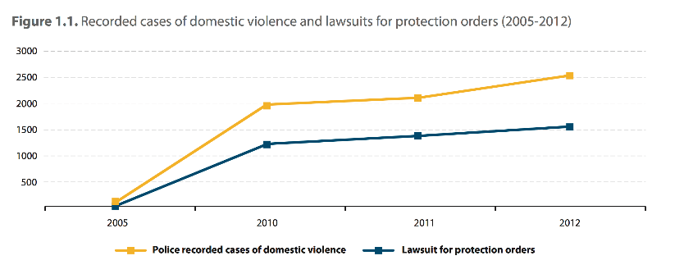
Statistics in Albania
14 % belonging to high school think of suicide
7 % actually attempt it
25 % of the woman getting abused
Notes:
In addition, 14% children belonging to high school think of suicide and approximately 7% actually attempt it every year. The number of student deaths by suicide is rising day by day as the bullying epidemic continues to spread. Gays and lesbians are more likely to be the target of bullying and the number of bullying episodes and the consequences are absolutely staggering. It is gradually impacting the youth. Previously, episodes of bullying were not as widespread and were reported to the right authorities by the audience watching it. However, conditions are deteriorating rapidly because not only the victims themselves but also the onlookers are unwilling to speak up against the act as they are fearful of being the next target. Child bullying is considerably more damaging although adult bullying also has its effects
In 1998, the government of Albania also adopted a new Constitution that advances principles of equality and non-discrimination, as well as protection and respect for human dignity, rights, and freedoms. For instance,
Article 18/2 maintains, “Everyone is equal before the law and nobody can be discriminated against on the basis of gender, race, religion, ethnicity, language, and political, religious and philosophical stands, economic, educational and social status.” Article 54/3 of the constitutions further maintains that every child has the right to be “protected from violence, maltreatment, exploitation and obligation for labor, especially under the minimal acquired age for labor, which can harm the health, moral or put the child’s life or normal development at risk.”
Since the government of the Republic of Albania ratified these various international conventions and adopted a new constitution, IOs and NgOs have been working in cooperation with the government to address issues of violence against women, including domestic violence against women. Collaborative efforts include developing prevention (education initiatives and public awareness raising campaigns), protection (victim support services, counseling services, and domestic violence shelters), and legal measures (domestic violence legislation that protects victims of domestic violence and sanctions batters) to address domestic violence. Domestic violence against women is not a new phenomenon in Albania; it has deep roots in the patriarchal
and 6% to 59% of women suffered sexual violence by an intimate partner (3). In 2013, the WHO conducted a meta- analysis of 185 studies from 86 countries and analyzed data from 155 studies in 81 countries and found that 30% to 37% percent of women who have been in a relationship have experienced physical and/or sexual violence by their intimate partners. This study also found that about 80% of this violence occurs in the home. In addition, this study found that 42% of women who had been physically or sexually abused by their intimate partners were injured, and 38% of all murders of women are committed by intimate partners (4).
Despite the similarities in women’s experiences with domestic violence across cultures and societies, understanding the specifics within a particular society is necessary for the development of legislative reform and policy development, prevention and intervention initiatives, and systems of protection and support for victims and survivors of domestic violence.
traditions and customs (e.g., strict gender identities and roles, patriarchal authority, adherence to an honor-and- shame system, and customs of hierarchal ordering with the family and intergenerational family control) that have long-shaped Albanian society. Forty years of communist rule in Albania (1946 – 1991) did not completely eradicate the deep-seated patriarchal attitudes, including those related to the kanun of Lek Dukagjini which was relevant in some regions of Albania. In fact, men and women in some part of Albania still reference the kanun to explain attitudes and opinions about gender roles and patriarchal authority, including the right of a man to ‘chastise’ his wife who is considered his property (9, 10).
In the last twenty-five years, the phenomenon of verbal bullying has been identifies as an issue in Albania, and in the last ten years this issue seems to have grown into a real problem. This article has presented the general perception of teenage students about verbal bullying and has examined the differences that exist between boys and girls regarding verbal bullying. This phenomenon is handled starting from the students’ perception of senior year in High School. The approach of this study was quantitative and the sample extraction is carried out through the stages sampling technique. For the data collection a Likert scale was used, with a Cronbah alpha coefficient reported of .71. The results from Mann-Whitney U test revealed significant difference between teenage boys and girls about verbal bullying. From the findings of this study, p = .000, r = .60, or 60 % of the variance of the perception of the students about verbal bullying is explained by gender, and boys are more exposed to verbal bullying than girls. Verbal bullying is recognized as one of the growing problems facing Albanian schools today. In the news broadcasts, especially during the last years, are transmitted hundreds of cases of verbal violence which later have degenerated into physical violence, injury or, in some cases, this conflicts have resulted to death. This phenomenon is found in almost all cases in the adolescent boys.
There are few research studies regarding bullying in Albania, and, more specifically, regarding verbal bullying, and this paper seeks to fill this vacuum about verbal bullying across contexts that has been conducted with participants in some of high schools in Albania. The main aim of this paper is to present the perception of high schools senior year students about verbal bullying and to explore the existence of statistical difference of verbal bullying between adolescents, boys and girls.
Bullying seems to be a clash between the powerful and the powerless, but power is an inacceptable feature of many aspects of human behavior.

Slide 8
Ethical System of a bully
They cannot be identified by their status, but by their conduct.
Notes:
Jekyll and Hyde nature - Dr Jekyll is "charming" and "charismatic"; "Hyde" is "evil";
Convincing liar - Makes up anything to fit his needs at that moment, and gets believed;
Treats some people in a way that causes them unprecedented levels of stress, frustration and fear;
Damages the health and reputations of organisations and individuals;
Reacts to criticism with denial, retaliation and by feigning victimhood and blaming victims;
Apparently immune from disciplinary action;
Moves to a new target when the present one burns out or leaves.

Slide 9
How the victim suffers?
Mentally
Physically
Problems Faced
Action plan for parents
Identify the indicators of bullying
Talk to your child
How you as a parent can help?
Contacting the school
Notes:
The bullying epidemic is a progressive act, which has different stages. The severity of bullying varies as per every stage. At first it starts from the looks and the stares from peers. Then the child has to suffer through giggles and whispers everywhere they go. Now is the stage of name calling, in which abusive language is included. The last step is the physical abuse in which children may be pushed, tripped or beaten. In some cases, bullying goes to such extremes that children are used as constant slaves and punching bags for entertainment purposes. This is damaging to the personality of the victim in particular. The scars of bullying last for a long time and sometimes are permanent is those children are not provided with proper counseling or therapy. The pits of bullying are the verbal assault that the child has to bear on a constant basis.
Problems Faced A teacher or adult might stop physical abuse but no one can put a stop to the verbal comments and snickers that a child has to face. It is said that despite being the smallest part of the body, the tongue can inflict damage of the highest degree. This is indeed true but the main dilemma is that many people choose to overlook bullying. This ignorance and compromise with the act has probably the reason behind the aggravation of the bullying epidemic. When caught fighting or abusing, in most cases, both the victims and bully are given the same punishment. This can further discourage the victim from speaking up and turn them against the system. Long term physical and emotional baggage is carried by children who are the victims of bullying but numerous teachers and parents choose to ignore it by saying that ‘it happens all the time’ or ‘it’s just a stage and will pass’. This is wrong and steps need to be taken to put a halt to it for proper upbringing of your child. Action plan for parents Parents often make the mistake of going in denial because they do not wish to believe that their child could be an outcast and they feel ashamed. They are unaware of how to deal with their children when they find that they have been the objects of bully. Read on further to know some of the steps you have to take when you find out if your child is a victim: Identify the indicators of bullying Figuring out that there is a problem can be difficult unless your child comes home with bruises or a black eye. The child’s personality will send up red flags when bullying occurs. A lack of interest in favorite activities changes in eating and sleeping pattern, depression and deviance from usual routine are all signs of bullying. If you suspect that your child is being bullied, it is best to talk to them first and explain that there is no harm in admitting it. Talk to your child First of all, you have to comprehend what bullying exactly and explain the same to your child. Experts have defined bullying as an act where a person intentionally torments someone in an emotional, physical and even psychological manner. You need to tell your child that bullies can do much more than pushing and hitting. Your child needs to understand the difference between personality differences and bullying because children often tend to confuse that. Bullies will try to scare you, say mean things about you and take away your lunch money. When someone tells your child that they don’t want to play together; that isn’t bullying. Bullying is when they tell others not to play with you. It is essential for your child to understand the distinction between these two acts. How you as a parent can help? Explain to your child that it isn’t their fault that they have become a victim. The self-esteem of your child would have been considerably damaged with constant bullying and you need to tell them that it’s not because of who or what they are. The problems actually exist with the bullies themselves. Appreciate your child for discussing the problem with you and assure them that by telling the truth they have also saved other children, as further bullying would be prevented. Your child also needs to know how to avoid the situation of bullying. You can suggest to them that they switch restrooms and go to a different one from the bully. Ask your child to make up a buddy system through which they are not alone whenever they are in the hallway. Explain to your child that reacting with tears and anger doesn’t help because it encourages the bully. Once the bully realizes that the victim is no longer getting upset, they will get bored. By pretending that the bully is invisible, you can make bullying boring for the bully. This requires practice but it is very effective. Contacting the school Contact the school administrators and address the situation with them. Don’t let things go, expecting them to be resolved on their own. Involvement of teachers and principals is necessary. If a bully is victimizing your child, there is a possibility that there are other victims as well. Become your child’s advocate and empower them to stand on their own. Before long, they will stop being bullied. Bullying is a very grave and serious business and more and more schools have established a policy of a zero tolerance approach to this act. However, this does not mean that it has stopped happening. Anti-bullying rules have been set up and teachers no longer opt to look the other way but the school authority can only do so much. Children will still find opportunities to bully and insult other kids and peers. Parents should empower their children at home and make them strong enough to deal with anything. Dealing with bullying is no easy task but it has to be handled the right way particularly when your child is the victim.

Slide 10
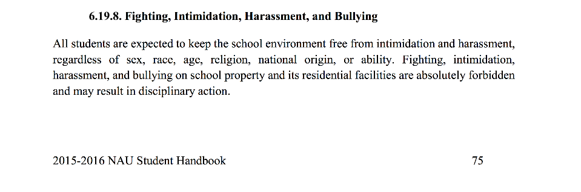
North American University

Slide 11
Video
https://www.youtube.com/watch?v=FYVvE4tr2BI

Slide 12
References
Besag, V. E. (1989). Bullies and Victims in Schools. Milton Keynes, England: Open University Press.
Boulton, M. & Underwood, K. (1992). Bully/Victim Problems Among Middle School Children. British Journal of Educational Psychology, 62, 73-87.
Caldwell, E. (Autumn/Winter 1997). Sticks and Stones. Perspectives: Research, Scholarship, and Creative Activity at Ohio University. Available on-line at: www.ohiou.edu/perspectives/9702/bully2.htm. Retrieved January, 2004.
Elliott, M. (1993). Bullies, Victims, Signs, Solutions. In M. Elliott (Ed.), Bullying: A Practical Guide to Coping for Schools (pp. 8-14). Harlow, England: Longman.
National Crime Prevention Council (2003). Bullying, Not Terrorist Attack, Biggest Threat Seen by U.S. Teens (press release). Washington, DC: National Crime Prevention Council.
Olweus, D. (1978). Aggression in Schools: Bullies and Whipping Boys. Washington, DC: Hemisphere.
Olweus, D. (2001). Peer Harassment: A Critical Analysis and Some Important Issues. In J. Juvonen & S. Graham (Eds.), Peer Harassment in School: The Plight of the Vulnerable and Victimized (pp. 3-20). New York: Guilford Press.
Randall, P. E. (1997). Adult Bullying: Perpetrators and Victims. London: Routledge.
Ross, D. (2003). Childhood Bullying, Teasing, and Violence: What School Personnel, Other Professionals, and Parents Can Do (2nd ed.). Alexandria, VA: American Counseling Association.
Swearer, S. M., Song, S. Y., Cary, P. T., Eagler, J. W., & Mickelson, W. T. (2001). Psychosocial Correlates in Bullying and Victimization: The Relationship Between Depression, Anxiety, and Bully/Victim Status. Journal of Emotional Abuse, 2(2/3), 95-121.
U.S. Department of Education (1998). Preventing Bullying: A Manual for Schools and Communities. Washington, DC: U.S. Department of Education.
Whitney, I. & Smith, P. K. (1993). A Survey of the Nature and Extent of Bully/Victim Problems in Junior/Middle and Secondary Schools. Educational Research, 35, 3-25.
Wolke, D. (December 24, 1999). In S. Cassidy, Beware the "Pure Bully" Who Never Takes Time Off. Times Educational Supplement, News Section, p. 3.

Slide 13
Bullying in Niger
Sekou Omar Barke Doka

Slide 14
Definition(Niger)
Bully in Niger is a power driven excessive use a force on other people like quoted by M. Alphonse Djédjé Mady in of his speeches at UNESDOC Niger is part of what he called "a world where the law of the strongest is always the best".(page 3, 2009

Slide 15
Characteristics
All the bullies in Niger are always the higher hierarchy of exercising force. The bully in polygamous family is the strongest wife usually the first however at school its is always the biggest kid compare to the other ones physically. The bully in the neighborhood is the one with more muscles and last the police and military who bend the laws to their favor.

Slide 16
Environment
We come in contact with bullies within polygamous families, schools, neighborhoods and most likely the police and the military.

Slide 17
Culture
Bully in Niger is a necessity of power and control. That necessity of power and control comes from the culture because Niger was before traditional with a lot of kingdoms with kings and social hierarchy and also slaves.
Gender
It’s happening within both female and male . They all share the same characteristics
Ethnicity is not anymore an issue because the rule of the strongest is apply.

Slide 18
Socioeconomic
Niger is a poor country where majority of the population are within the lower class therefore a lot of Terrorism and Violent actions happen to gain control. The lower class have a more violent bullying experience however the few middle class bully each other through their ability to pay for big muscles or intimidation .
In addition BBC reported that "basic rights issues, such as slavery - which was only banned in 2003 and still remains a problem - and a high rate of illiteracy and disease, remain stubborn challenges."

Slide 19
References
Cérémonie Du XXe Anniversaire Du Prix Félix Houphouët-Boigny Pour La Recherche De La Paix, UNESCO, 27 Octobre 2009: Discours De M. Alphonse Djédjé Mady, Secrétaire Général Du PDCI-RDA (Côte D'Ivoire), Représentant Le Président Henri Konan Bédié, Protecteur Du Prix Félix Houphouët-Boigny Pour La Recherche De La Paix; 2009. N.p., n.d. Web. 18 Apr. 2017.
"Niger Country Profile." BBC News. BBC, 05 Jan. 2017. Web. 18 Apr. 2017.

Slide 20
Bullying in Turkmenistan
Maksat Taganov

Slide 21
What is bullying like in Turkmenistan?
Definition- use superior strength of governors to intimidate low level occupied people.
Characteristics – Fear of loosing job, intimidation affecting to family members.
Contributing factors – cultural

Slide 22
Continued..
Bully rationale – exaggerated use of Government power, lack of freedom in media.
Ethical system of bullying – Ego, definitely.​
Location – workplaces, personal relationships
Consequences – socially passive, hopeless.
View to bully – not appreciated, but cultural adapted

Slide 23
Why happens? - society is educationally suppressed ​
How to stop? - Everybody should be same and get educated.
Bullying in Turkmen - "Kemsitmek"

Slide 24
References
http://www.rferl.org/a/24438614.html
https://www.hrw.org/world-report/2014/country-chapters/turkmenistan
http://www.saglyk.info/makalalar/hyzmatdasymyzyn-pikirleri/55-umumy/1322-zenanlary-peseldyan-zahmet-koce-supurmek.html

Slide 25
Bullying in Turkey
Enes Sevik

Slide 26
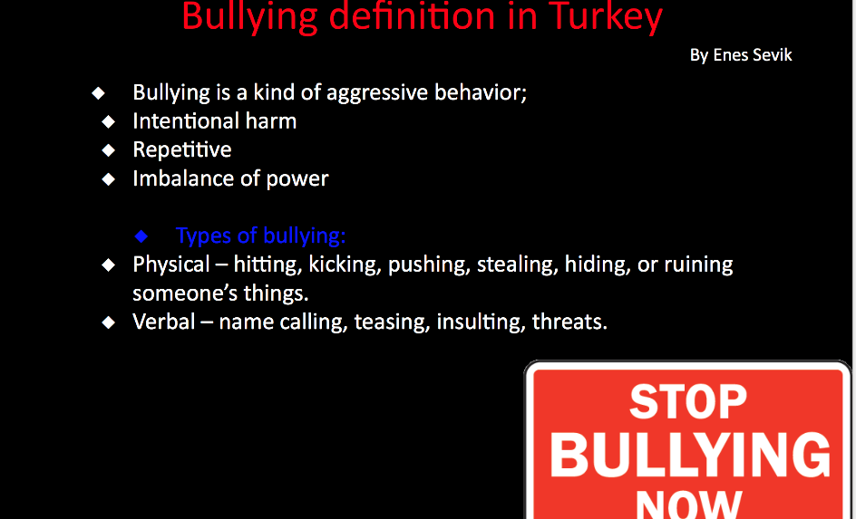

Slide 27
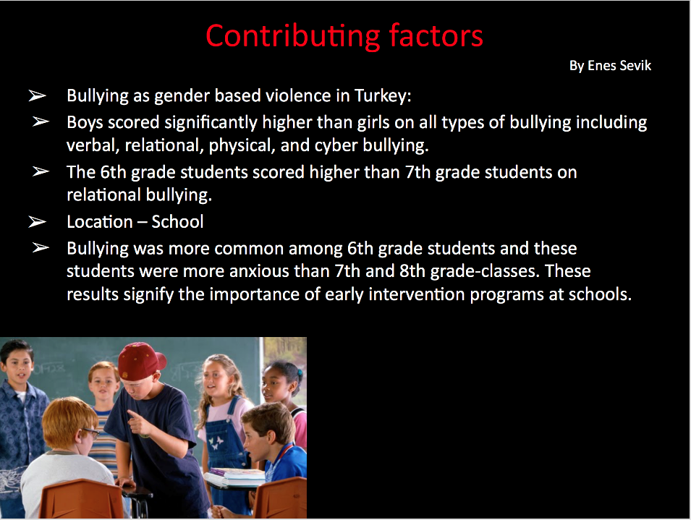

Slide 28
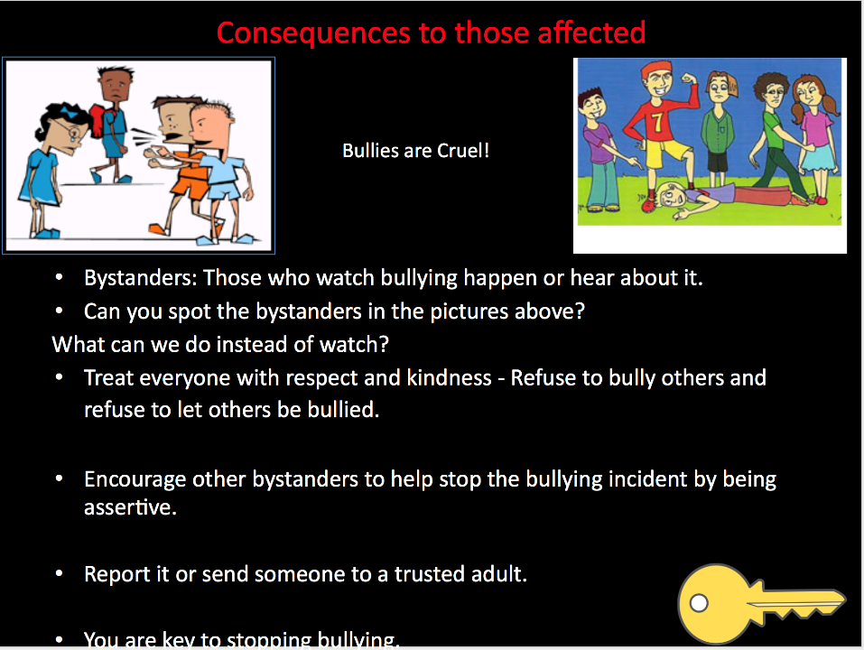

Slide 29
Bullying in Kyrgyzstan
Ravshanbek Norboev

Slide 30
Definition – a person who engages in repeated intentional actions that hurt others physically and emotionally
Bullying can be determined as ongoing verbal, physical or social that occurs in community places such as in street, school etc. Bullies use aggression or threat of it, to gain dominance over peers.
Nearly all children experience bullying.
Bully – Kordoo (Translation to Kyrgyz Language)
Another terming to bully is Reket

Slide 31
There are factors of bullying which can increase of a person becoming a bully.
Family challenges
A lack of attention from parents are highly to develop bullying behaviors
Show Physical Strength
get control by making the others feel weak or powerless
Subjection to Bullying
Children who are victimized by other bullies can often offset for their pain by bullying other children.
Academic Failure
Children who are struggling or failing at school can often show bullying behavior.

Slide 32
Contributing factors – Kyrgyzstan (Continue)
In our country, we are do not use the bully word, but we do have actions that are similar to bullying.
Bullying is Reket in our word It's when one or a group of bad boys take money or mobile phones from children. Or feel powerful to do bad things to the weaker person.
In our culture, without any reason, people will not bully. We have a situation that happens bully but in my country who saw the situation, they will try to stop and explain that is wrong and give them advice to not be a bully in public places and workplaces.
However, in every school of Kyrgyzstan has bullying issues. In the schools of Kyrgyzstan school boys or girls take money or valuable things of the younger ones.
Reket interferes with learning at school.
Notes:
In my country we are not using word bully but we have a lot of situations that same as bully especially in schools. In every school has bullying issues. Senior students try to get money or valuable things from weaker students. In other words it is called Reket which group of people or one person gets the money or tries to harm without any reason. But

Slide 33
Contributing factors – Kyrgyzstan (Continue)
The affects of bullying in schools.
Almost half of the school or class were not going to school at all.
By following senior students junior students also tries to harm little students, it goes on and on.
Who became victim of that got physiological problems
Stress
Panic attacks
Loss of self-esteem
Physical effects
They get bloody noses, cuts, and even knife wounds
Notes:
By the result of school bullying or reket, who the victim of that got a lot of physical or mental effects. such as stress, panic attacks, loss of self-esteem even suicidal thoughts. Very bad things happened after the group of reket such as serious injuries or even death. In Kyrgyzstan's schools, biggest problem is school bullying

Slide 34
Contributing factors – Kyrgyzstan (Continue)
Workplaces
we do not have actions that are similar to bully but they just arguing something. By a result of that, they fight they fired from jobs. No one gets the benefit of arguing or bullying because there is no good things of that.
Society
In public we do not a sign of bully. Everyone respects and helps each other.

Slide 35
Contributing factors – Kyrgyzstan (Continue)
Statistics of bullying
In schools is higher
By the result of bullying in (2008) study shows 43.4 percent of students were not going to school at all.
In workplaces is lower
Bully happens with a reason. Everybody knows own work, own responsibilities.
In public places is lower
There not a situation like a bully. Everybody smiles to you and helps. I never saw situations that bully happened in society.
Notes:
Statistics of bullying in Kyrgyzstan is really high in school, lower in workplaces, and lower in society. In our country very big problem in bully is in schools, almost in every schools have a situation like a bullying, harm someone, or stealing. In workplaces we do not have that kind of problem everbody knows what they are doing and respects each other. In public places is very quiet, whenever bad happens peoples of my country ready to help. I NEVER SAW bully in society.

Slide 36
References
Kyrgyzstan Student Blog. (2012). Reket (school bullying) in Kyrgyzstan. Retrieved from: http://kgstudents.blogspot.com/2012/03/first-year-law-students-college.html

Slide 37

Bullying in
Mehmet Icme & Hakan Bilgi

Slide 38
Definition of Bullying
Definition of bullying in Turkish is to scare someone, teasing or an act of intimidating a weaker person to do something
Bullying occurs almost everywhere in Turkey.
People get bullied in schools, workplace, bus, home, hospital, military etc.

Slide 39
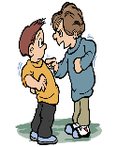
Statistics of Bullying in Turkey (2002)
According to a 2002 study of 692 high school students in Turkey, every single one reported being bullied.
35.5% of students reported being the victim of physical bullying.
33.5% of students reported being the victim of verbal bullying.
28.3% of students reported being the victim of emotional bullying.
15.6% of students reported being the victim of sexual bullying.

Slide 40

GENDER
According to the study in Turkey boys experiencing more physical and verbal bullying than girls.
However, both genders reported experiencing the most common types of bullying, such as pushing and name calling.
Cultural norms of Turkey’s gender roles to include gender based violence as a form of bullying that includes regulating women’s bodies as well as bullying because of sexual orientation as with the gay and lesbian community as well as transsexuals.

Slide 41
Ethnicity
Ethnicity is also a reason to bully for people. There are also Kurdish people living in Turkey and some of the parts of Turkey, Kurdish people bullies Turkish people and in some of the places Turkish people bullies Kurdish people because of their ethnicity and political issues.

Slide 42

Government Bullies to People
The recent failed coup in Turkey has resulted in bullying on a national scale with sixty-two school children arrested for treason as well as teachers, public servants, professors, journalists and many others arrested as the current government purges the country of any opposition to its rule.

Slide 43
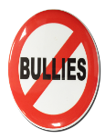
How to Avoid Bullying ?
Professional trainings for teachers and families to promote awareness of bullying in Turkey.
Creating a framework for reporting bullying in schools and to other authorities.
Training for children that bring awareness to bullying and teach children important social skills for communicating effectively.
Training for children and parents on how to safely use the Internet, particularly social media.

Slide 44
Sources
https://nobullying.com/bullying-in-turkey/
https://www.ncbi.nlm.nih.gov/pmc/articles/PMC2796963/
https://www.hindawi.com/journals/tswj/2013/851839/

